Slide 1
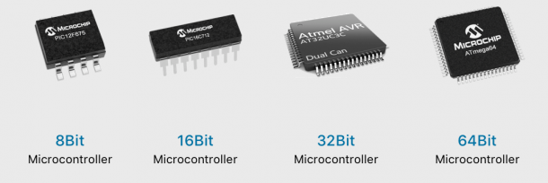
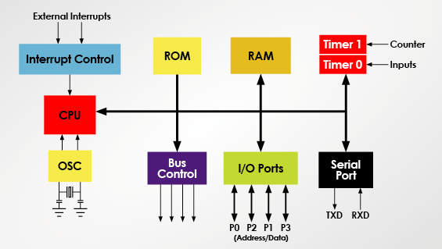
Micro Processing System
Micro-Controller and Micro-Processor Unit
VÕ TUẤN BÌNH
binh@hcmut.edu.vn

Slide 2
Zalo Group
15 weeks for Lectures
MCQs for Mid-term (40%)
MCQs for Final-term (60%)

Slide 3
15 Weeks for Lectures
Understand microcontroller basics including all common interfaces:
General Input/Output GPIO (LEDs, Buttons)
Interrupts: Timer Interrupt
Serial communications: UART, I2C, SPI

Slide 4
Weeks for Labs
Software requirements:
STMCubeIDE
Proteus simulations
Github

Slide 5
Microcontroller and Microprocessor Applications
Networking & communications
phones, modems, switches, routers, signal processors
Embedded products & systems
consumer electronics, appliances, entertainment devices, medical devices, security, transportation
Scientific instruments & equipment
simulation, testing, sensing, logging, reporting, analyzing
Many more.

Slide 6
Microprocessor vs Microcontroller
MPU | MCU
Stand-alone CPU, RAM, ROM and IO (and Timer) are separated | CPU, RAM, ROM and IO (and Timer) are all on a single chip
ROM, RAM and IO can be customized | ROM, RAM and IO are fixed
Expensive, versatility and general purpose | Low cost, power and single-purpose (control-oriented)
High resource of power, processing and memory (for AI inferences) | Low resource of power, processing and memory (for device controller)
Normal Operating System (32 or 64 bits) | Real Time Operating System (8 or 16 bit)

Slide 7
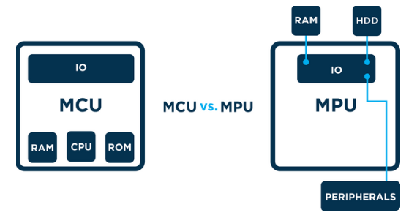
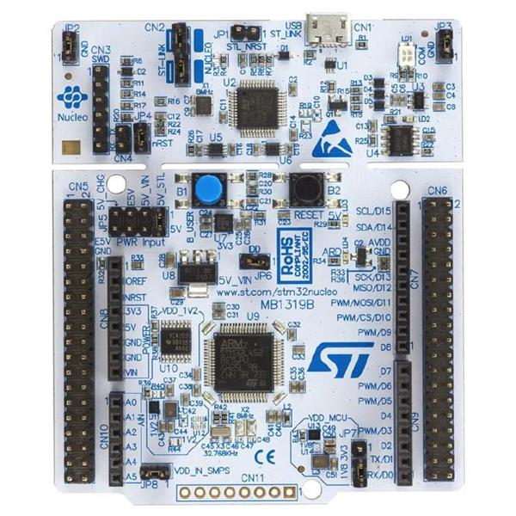

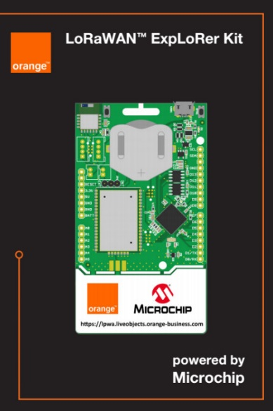
Micro-Controller Platform
Micro-Controller Unit (MCU) contains RAM, ROM and IO
Micro-Processor Unit (MPU) only contains the CPU
System on Chip (SoC) refers to MCUs with a greater number of onboard peripherals and functionality
http://www.ti.com
http://www.microchip.com

Slide 8
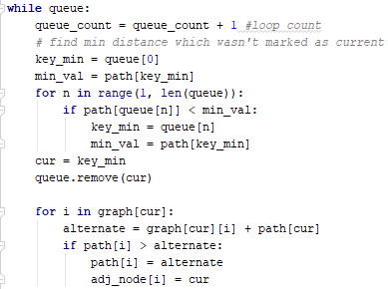
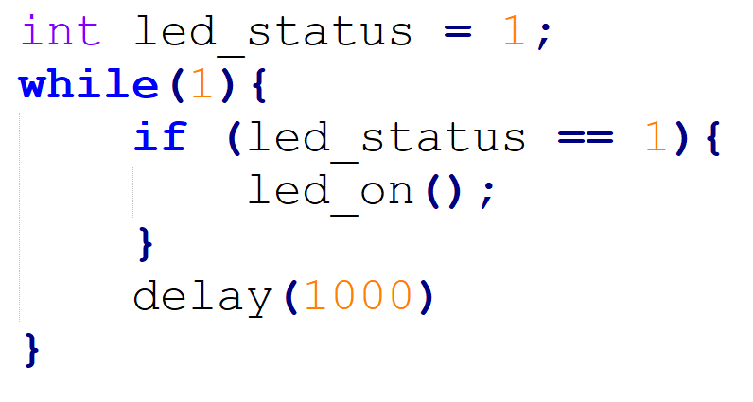
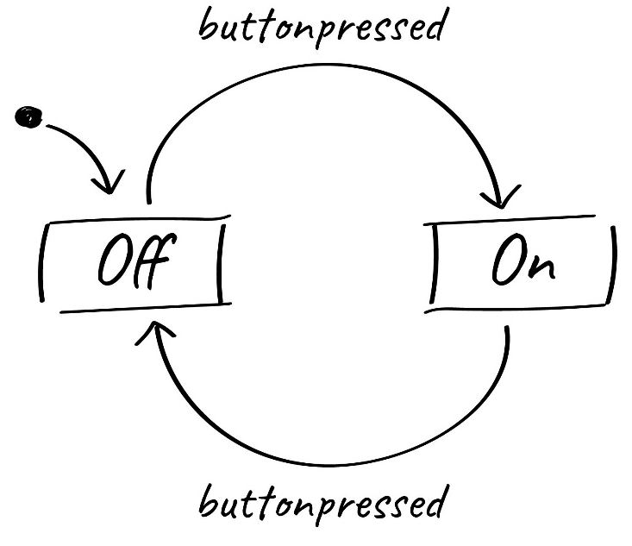
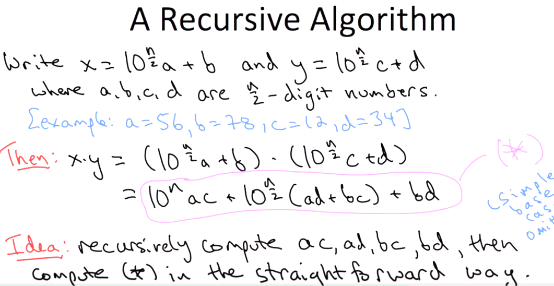
Program on MPU vs MCU

Slide 9
Warm up Exercises
LED turns on and off every second (LED Blinky)
LED turns on for 3 seconds and then turns off for 5 second.
Digital Clock with hour, minute and second
Change the delay from 1000 to 10

Slide 10

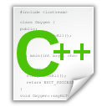
C Language: Header and C++ Files
#include “led.h”
int T_on;
int T_off;
int counter;
void setOn(long duration){
//TODO: set LED on here
}
void setoff(long duration){
//TODO: set LED off here
}
void delay(long duration){
//TODO: set delay here
}
#ifndef __LED_H_
#define __LED_H_
#include <system_lib.h>
#include “user_lib.h”
#include “UserFolder/lib.h”
extern int T_on;
extern int T_off;
void setOn(long duration);
void setoff(long duration);
#endif

Slide 11
C Language: Main File
#include “led.h”
#include “timer.h”
#include “gpio.h”
#include “button.h”
void main(){
initGPIO();
initTimer();
initButton();
initLED();
….
….
while(1){};
}
void timer_isr(){
}
void ext_isr(){
}
Modules/ Libraries are included
LED
Modules/ Libraries are initiated
TIMER
GPIO
System operations are implemented in interrupt functions
BUTTON

Slide 12
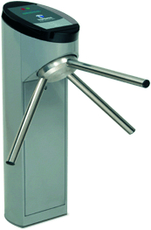
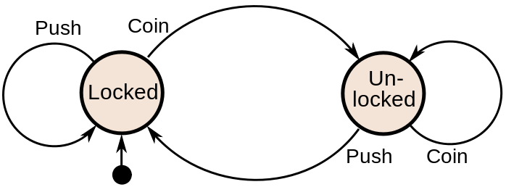
Finite State Machine (FSM)
Finite-State Machine (FSM) or Deterministic Finite Automata (DFA), finite automaton, or simply a state machine, is a mathematical model of computation
Current State | Input | Next State
Locked | Coin | Unlocked
 | Push | Locked
Unlocked | Coin | Unlocked
 | Push | Locked
A turnstile

Slide 13
Finite State Machine Programming
while(1){
switch(status){
case LOCKED: lock_turnstile(); //operation in a state
if(Coin == true) //transition condition
status = UNLOCKED; //next state
break;
case UNLOCKED:
unlock_turnstile(); //operation in a state
if(Push == true) //transition condition
status = LOCKED; //next state
break;
default:
break;
}
}

Slide 14
Example
Given an LED turns on for T_on and then turns off for T_off.
Design an DFA for this LED
Implement the DFA in Arduino
digitalWrite(13, HIGH): turn on the LED
digitalWrite(13, LOW): turn off the LED
setTime(duration): set a clock (timer_flag = 0), when the clock is expired, timer_flag = 1; duration is in mili-seconds.

Slide 15
Answer
timer_flag == 1
INIT
LED_ON
LED_OFF
timer_flag == 1
INIT: Set pin 13 to OUTPUT mode, set timer
LED_ON: Turn on the LED
LED_OFF: Turn off the LED

Slide 16
Answer (Arduino Code)
void loop(){
switch(status){
case INIT: pinMode(13, OUTPUT);
setTimer(T_on);
status = LED_ON;
digitalWrite(13, HIGH);
break;
case LED_ON:
if(timer_flag == 1){
status = LED_OFF;
setTimer(T_off);
digitalWrite(13, LOW);
}
break;
case LED_OFF:
if(timer_flag == 1){
status = LED_ON;
setTimer(T_on);
digitalWrite(13, HIGH);
}
break;
default:
break;
}
delay(10);
}
void timer_run(){
if(timer_counter > 0)
timer_counter--;
if(counter_timer == 0)
timer_flag =1;
}
void setTimer(long duration){
timer_counter = duration;
timer_flag = 0;
}

